Slide 1
Multimedia System and Virtual Environment
CSE – 310
Lecture 17
Digital Watermarking for Multimedia Security
Dept. of Computer Science and Engineering, University of Rajshahi

Slide 2

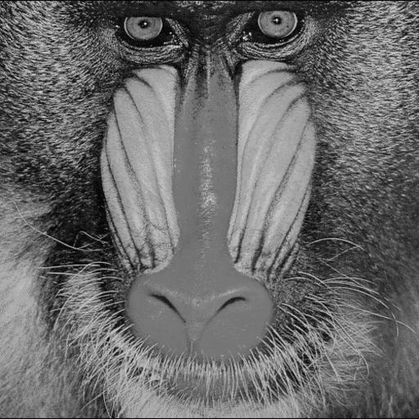
Example:LSB Encoding
Original Image Watermark
Dept. of Computer Science and Engineering, University of Rajshahi

Slide 3
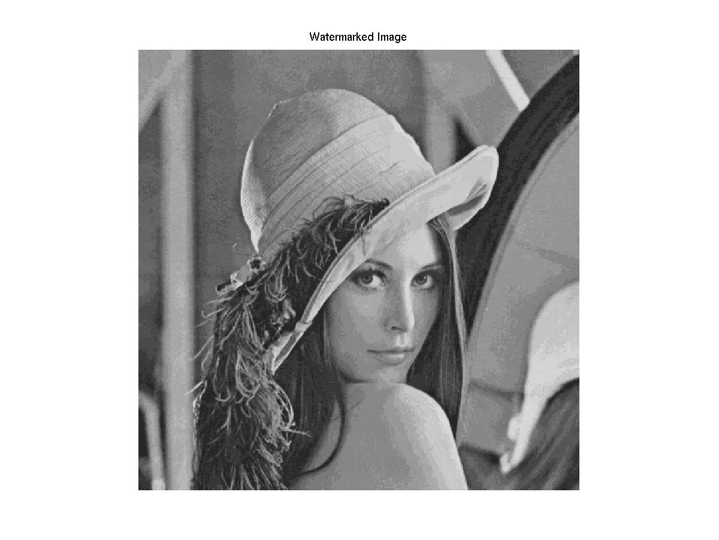
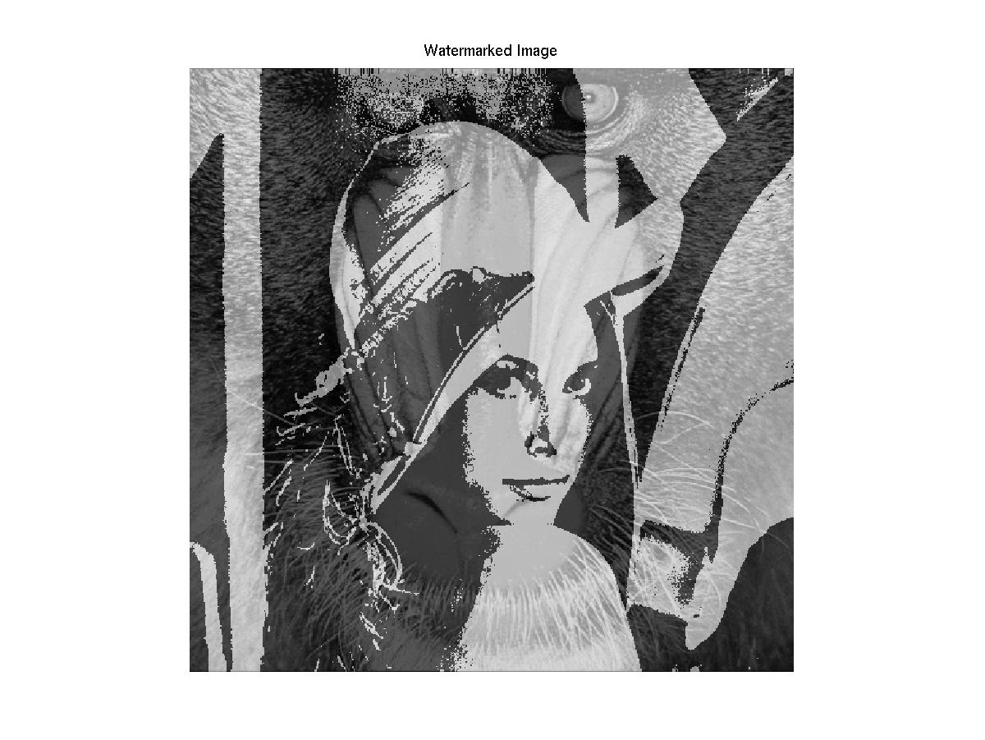
Replace 4 and 7 LSBs of Original
4 LSBs Watermarked 7 LSBs Watermarked
Dept. of Computer Science and Engineering, University of Rajshahi

Slide 4
What is a Watermark?
A watermark is a “secret message” that is embedded into a “cover (original or host) message”.
Only the knowledge of a secret key allows us to extract the watermark from the cover message.
Effectiveness of a watermarking algorithm is a function of its
  Resilience to attacks.
  Capacity.
  Stealth.
Dept. of Computer Science and Engineering, University of Rajshahi

Slide 5
What Can Be Watermarked?
Multimedia data.
  Video.
  Audio.
  Still Images.
  Documents.
Software.
Hardware designs.
Dept. of Computer Science and Engineering, University of Rajshahi

Slide 6
Multimedia Watermarks
A digital watermark is a “secret key dependent” signal “inserted” into digital multimedia data.
Watermark can be later detected/extracted in order to make an assertion about the data.
A digital watermark can be.
  Visible (perceptible).
  Invisible (imperceptible).

Slide 7
Watermark Applications
Proof of ownership.
Copy prevention or control.
Content protection (visible watermarks).
Authentication.
Media Bridging.
Broadcast Monitoring.
Fingerprinting.
Secret Communications.
Dept. of Computer Science and Engineering, University of Rajshahi

Slide 8
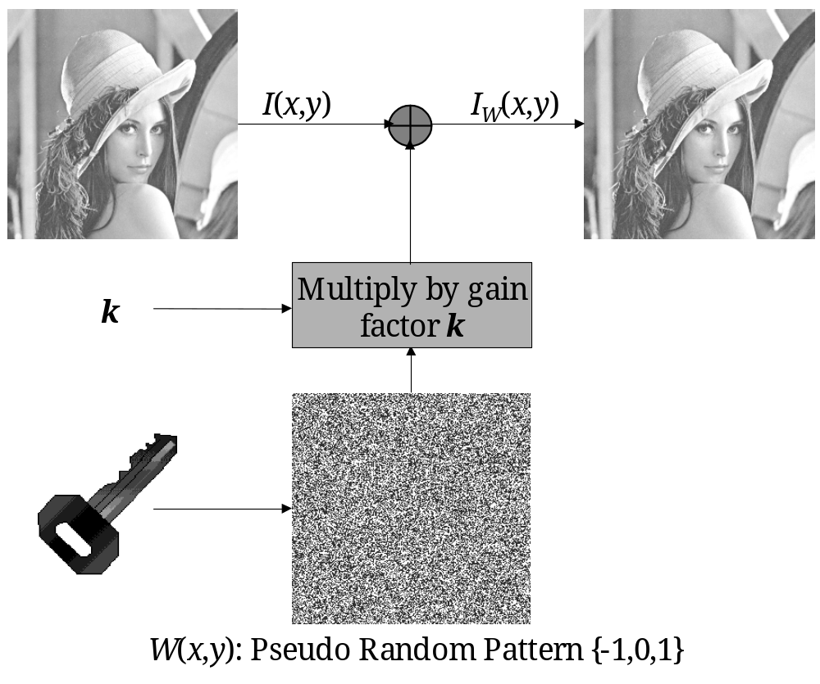
Example: Additive Watermarks
I_{W}(x,y)= I(x,y)+ k ⋅ W(x,y)
Dept. of Computer Science and Engineering, University of Rajshahi

Slide 9
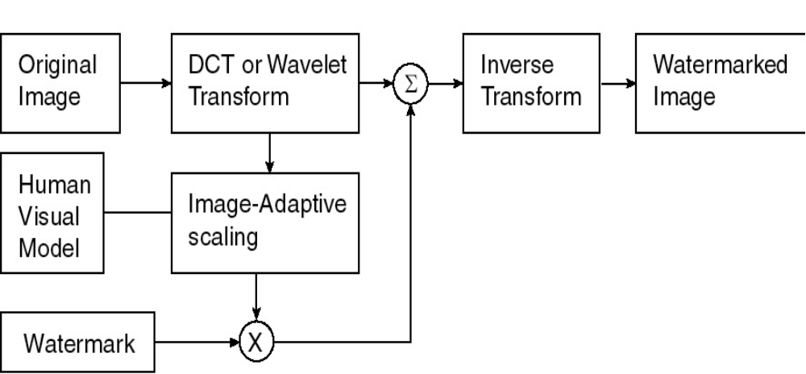
The image adaptive watermarking procedure
Dept. of Computer Science and Engineering, University of Rajshahi

Slide 10
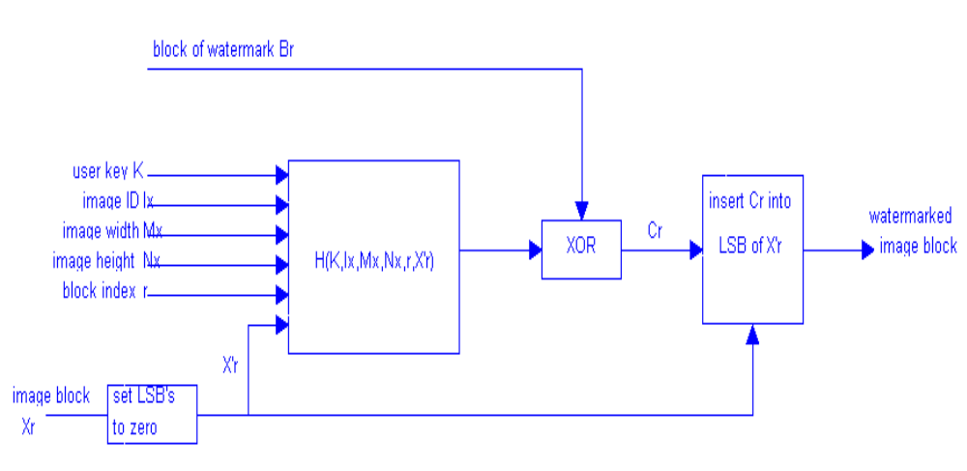
Secret Key Authentication/Verification Watermark
Figure: insertion procedure of the watermark signal to each image block
Dept. of Computer Science and Engineering, University of Rajshahi

Slide 11
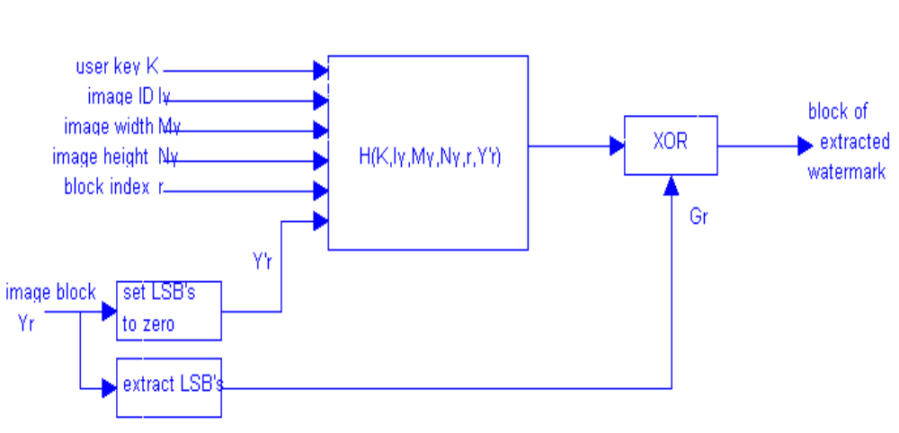
Secret Key Authentication/Verification Watermark
Figure: block diagram of the extraction procedure for each block
Dept. of Computer Science and Engineering, University of Rajshahi

Slide 12
Watermark Attacks
Active Attacks.
  Hacker attempts to remove or destroy the watermark.
  Watermark detector unable to detect watermark.
  Key issue in proof of ownership, fingerprinting, copy control.
  Not serious for authentication or covert communication.
Dept. of Computer Science and Engineering, University of Rajshahi

Slide 13
Watermark Attacks
Passive Attacks.
  Hacker tries to find if a watermark is present.
  Removal of watermark is not an aim.
  Serious for covert communications.
Collusion Attacks.
  Hacker uses several copies of watermarked data (images, video etc.) to construct a copy with no watermark.
  Uses several copies to find the watermark.
  Serious for fingerprinting applications.
Dept. of Computer Science and Engineering, University of Rajshahi

Slide 14
Watermark Attacks
Forgery Attacks.
  Hacker tries to embed a valid watermark.
  Serious in authentication.
  If hacker embeds a valid authentication watermark, watermark detector can accept bogus or modified media.
Dept. of Computer Science and Engineering, University of Rajshahi

Slide 15




Example: Forging Photo I.D.
Millionaire with Swiss bank account
Bad Forgery!
Thanks
Hong Man, for this picture!
Assistant Professor
Dept. of Computer Science and Engineering, University of Rajshahi

Slide 16
I, P, and B-frame
I-frame
Short for intraframe, a video compression method used by the MPEG standard.
An I-frame is a single frame of digital content that the compressor examines independent of the frames that precede and follow it and stores all of the data needed to display that frame.
A I-frames are interspersed with P-frames and B-frames in a compressed video.
The more I-frames that are contained, the better quality the video will be; however, I-frames contain the most amount of bits and therefore take up more space on the storage medium.
Dept. of Computer Science and Engineering, University of Rajshahi

Slide 17
Example: Forging Photo I.D.
P-frame
Short for predictive frame, or predicted frame, a video compression method used by the MPEG standard.
P-frames follow I-frames and contain only the data that have changed from the preceding I-frame (such as color or content changes).
P-frames depend on the I-frames to fill in most of the data.
B-frame
Short for bi-directional frame, or bi-directional predictive frame, a video compression method used by the MPEG standard.
B-frames rely on the frames preceding and following them.
B-frames contain only the data that have changed from the preceding frame or are different from the data in the very next frame.
Dept. of Computer Science and Engineering, University of Rajshahi

